Slide 1
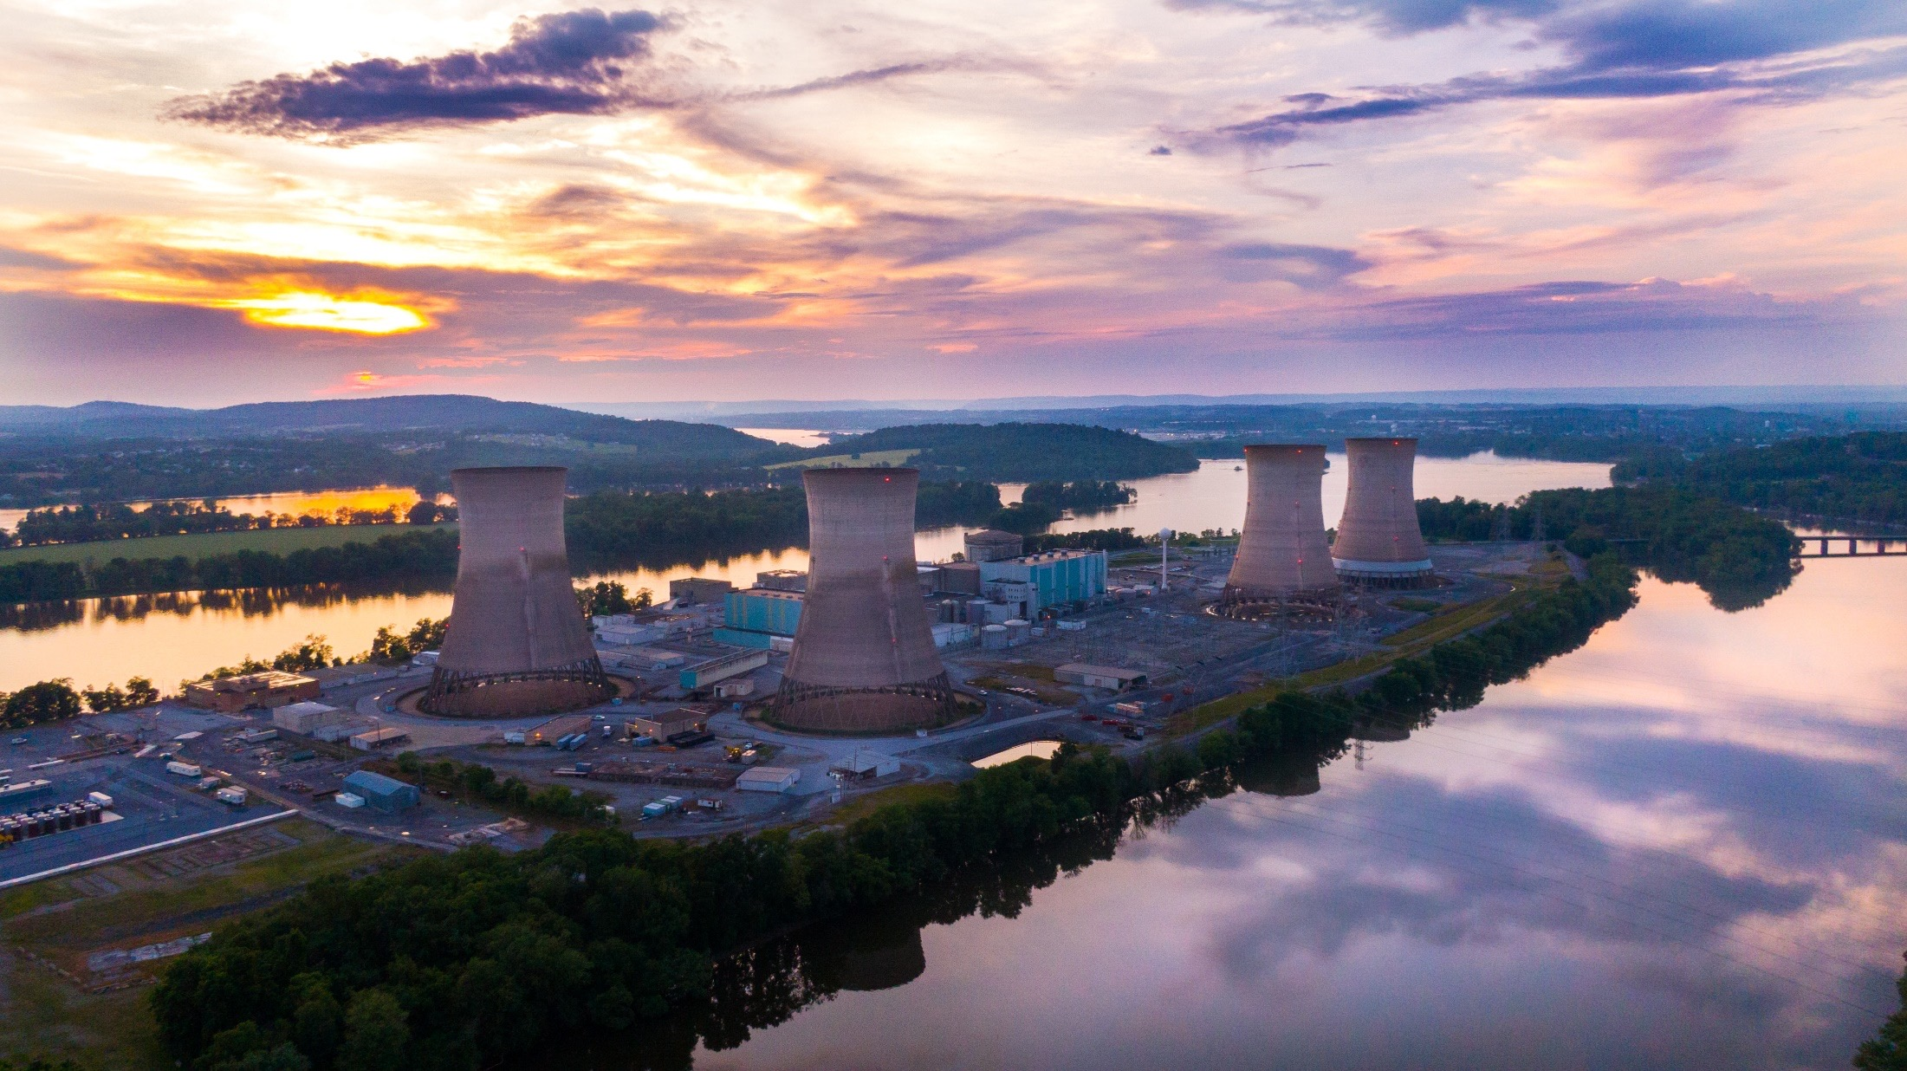
TMI-2 CAP Meeting
Date: March 20, 2025
Time: 6:00pm – 7:30pm
Meeting Access
Virtual: Microsoft Teams through
www.tmi2solutions.com
Dial In: +1 385-500-4880
With Conference ID 377086967#
In-Person: Penn State Harrisburg
Olmstead Building, W107 Gallery Lounge,
777 W Harrisburg Pike, Middletown, PA 17057

Slide 2
Welcome & Attendance
David J. Allard, CHP
Chairperson,
TMI-2 Community Advisory Panel

Slide 3
TMI-2 CAP Agenda
Introduction
CAP Business
Decommissioning Status Update
Environmental Monitoring Update
Regulatory Update
Oversight Comments
  TMI-2 Decommissioning Nuclear Safety Review Board (DNSRB)
  PADEP Bureau of Radiation Protection
  Nuclear Regulatory Commission (NRC)
CAP Business & Open Discussion
Community Q&A

Slide 4
TMI-2 CAP Introduction
What is the TMI-2 Community Advisory Panel?
  A volunteer, non-regulatory body formed to enhance open communication, public involvement and education about the TMI-2 Nuclear Power Station decommissioning project.
  Serves as a conduit for public information and as a formal channel of community involvement and communication related to the decommissioning project.
  Provides community feedback to TMI-2Solutions including any issues or concerns related to TMI-2 decommissioning activities.
  Includes a broad cross-section of members who are nominated by various community, business, and government organizations from around Three Mile Island.

Slide 5
TMI-2 CAP Business
Approval of Previous CAP Minutes
TMI-2 CAP Membership
  Member attendance
  Nominations and vote for CAP Vice Chair
Next CAP Meeting - Please check your calendars for Wednesday, September 24, 2025.
  Solicit input from CAP Members for future topics

Slide 6
TMI-2 Decommissioning Status Update
Paul Ross
TMI-2 Project Director

Slide 7
Agenda
TMI-2 Background
TMI-2 Decommissioning Project Update
Waste Update
Environmental Monitoring Maps
Regulatory Update

Slide 8
Visitors / Communications
TMI-2 Tour Activities
  PA State Historic Preservation Office / PA Historical Museum / PADEP Tour
    11/20/24 → turnover of some historical items (lucite model of damaged core, etc)
  PA DEP and Japanese Regulatory Tour – January 2025
Routine calls with PA Bureau of Radiation Protection and PA State Historic Preservation Office (SHPO)

Slide 9
TMI-2 Decommissioning Project Update
Phase 1 – Planning, Engineering, Remediation
  Phase 1a – Preparation for Decommissioning
  Phase 1b – Fuel Bearing Material Recovery and Source Term Reduction (2023 – 2029)
Phase 2 – Typical Decommissioning and Dismantlement, Site Remediation, License Termination (2030 – 2037)
Phase 3 – Fuel Bearing Material Management (2029 – 2052)

Slide 10
Phase 1b Schedule
PSDAR / Schedule
  Post-Shutdown Decommissioning Activities Report (PSDAR) communicates a high-level Project schedule
TMI-2 has unique challenges…
  Source of remaining radiation at TMI-2 is distributed throughout the Reactor Building (RB) and portions of the Auxiliary and Fuel Handling buildings
  Project Leadership continues to review the schedule of activities and evaluate needed resources to complete cleanup.
TMI-2 Waste Disposal…
  2024 4Q Class A Disposal Shipments – 14
    8,826 ft3
  2025 1Q Expected Class A Disposal Shipments – 9
    1 Additional Shipment for Off-site Processing

Slide 11
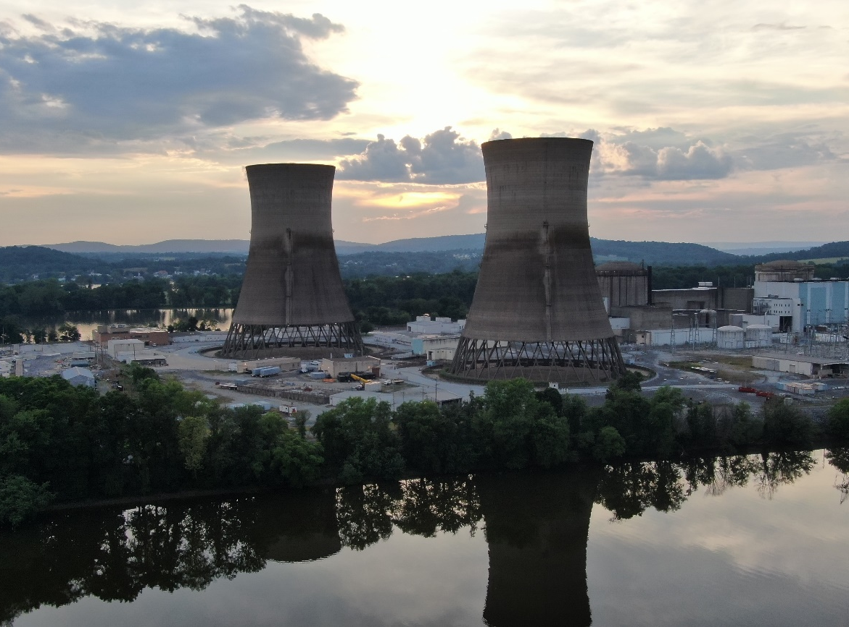
Phase 1b Activities
Phase 1b activities include:
Removal, packaging, and storage of remaining Fuel Bearing Material (FBM)
Independent Spent Fuel Storage Installation (ISFSI) Construction for interim storage of remaining Fuel Bearing Material
Dose reduction and decontamination of locked High Radiation Areas
Packaging and transportation of Radioactive Waste (Class A, B/C, and FBM)
Decontamination of radioactive systems and components

Slide 12

Key Scope Progress
Equipment Hatch (EH) Enlargement
Removed majority of cement surrounding EH and portion of EH shell
Decommissioning Support Building (DSB) Construction
Completed DSB slab, Construction started
Spent Fuel Pool (SFP) Preparation
Removed items in and around the Spent Fuel Pool A (SFP-A)
Filling SFP-A to provide a resource for decontamination water and processing
Reactor Building (RB) Coolers
Removal of significant source term near the RB entry
Robotics, Instrumentation, Systems, & Tooling (RIST) Committee
Use of Robotics
Evaluation of new technologies

Slide 13
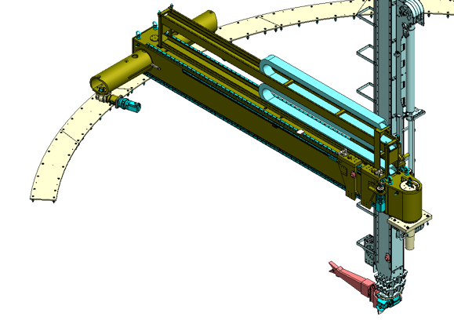
Key Scope Progress
Independent Spent Fuel Storage Installation (ISFSI)
Pad completion
Polar Crane Refurbishment
Maintenance and qualification of equipment
Robotics, Instrumentation, Systems, & Tooling (RIST) Committee
Use of Robotics
Evaluation of new technologies
Remote Tooling

Slide 14
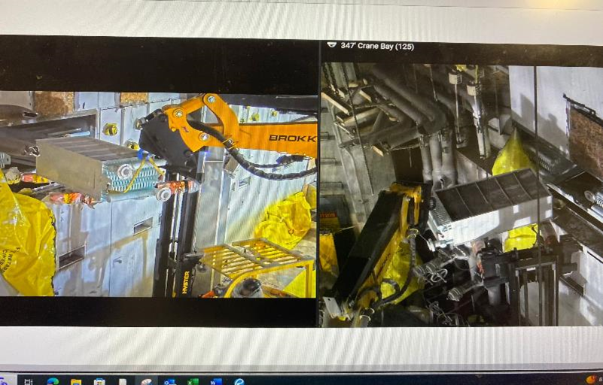
Decommissioning Work:
Robotic Equipment and Training
Reactor Building Cooler Removal

Slide 15
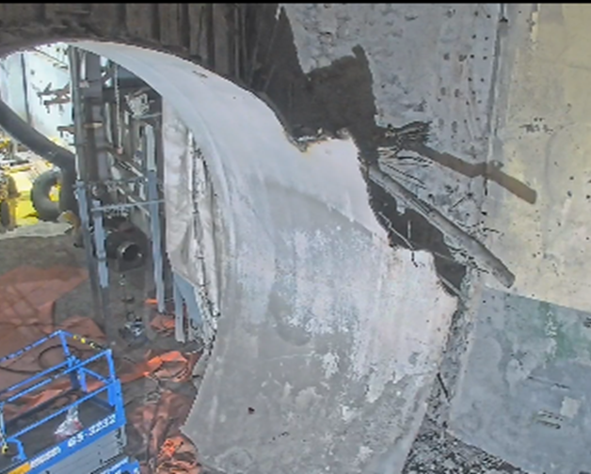
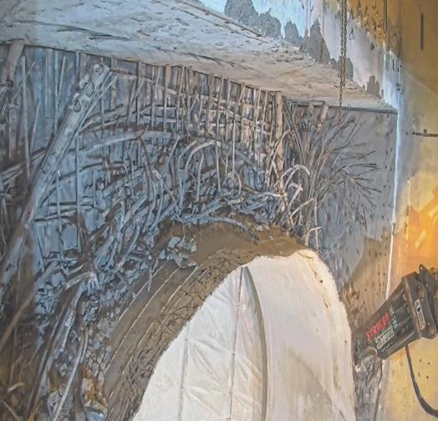
Decommissioning Work:
Equipment Hatch Enlargement

Slide 16
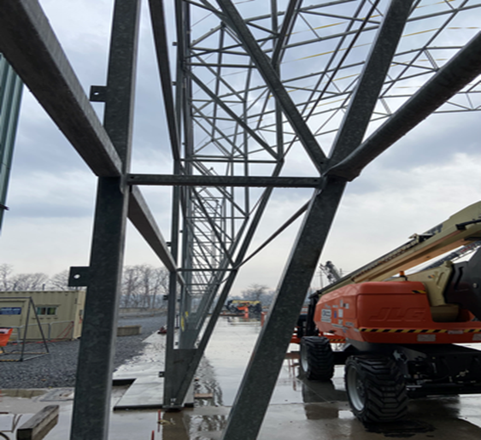
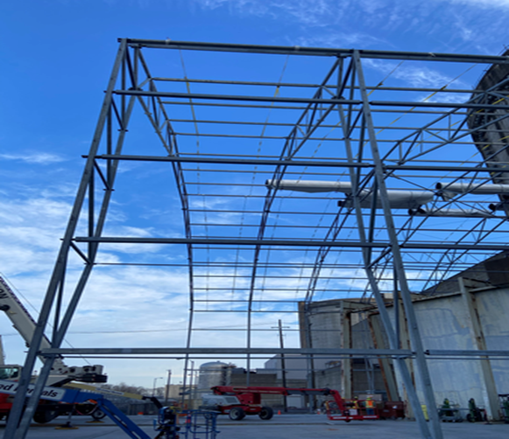
Decommissioning Work:
Decommissioning Support Building (DSB)

Slide 17
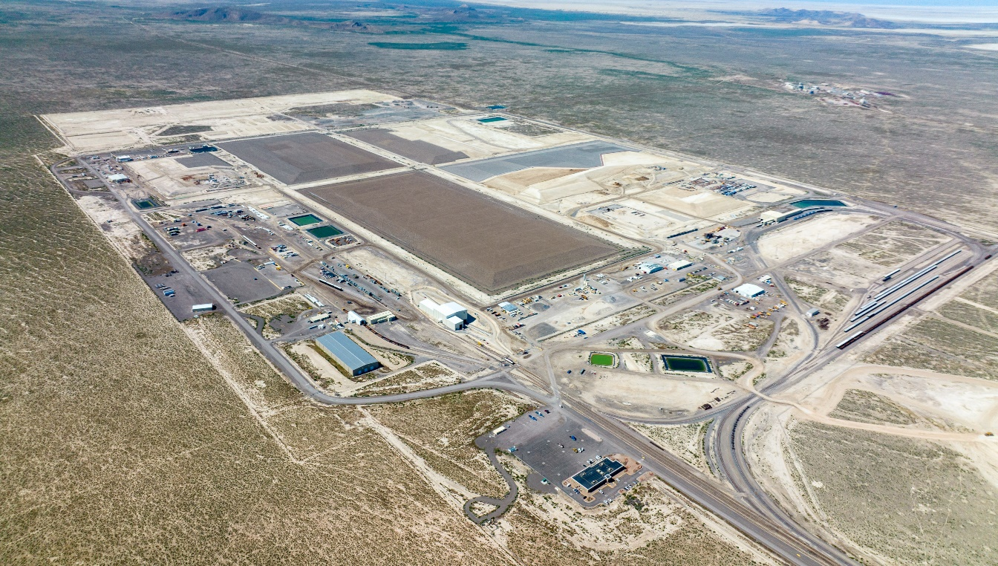
Waste Planning and Shipments
ISFSI pad is in complete, awaiting Project advancement to FBM removal and storage
Low-Level Radioactive Waste Shipments (Class A) to Clive facility
  30 shipments planned for 2025
  Total Shipments to date: 39,846 cubic feet, 1.01 curies.
  RB Cooler shipments may be Class B and will go to Waste Control Specialists (WCS) in Texas
EnergySolutions’ Waste Facility in Clive, Utah

Slide 18
Environmental Monitoring Update
Mark Cambra
TMI-2 Environmental Manager

Slide 19
Environmental Monitoring
    Potential Exposure Pathways to Members of the Public due
    to Plant Operations/Activities

Slide 20
Environmental
Monitoring
    Environmental Sampling Locations Within One Mile of the Three Mile Island (TMI) Station

Slide 21
Environmental Monitoring
    Environmental Sampling Locations Between One and Five Miles of the Three Mile Island (TMI) Station

Slide 22
Environmental Monitoring
    Environmental Sampling Locations Greater than Five Miles of the Three Mile Island (TMI) Station

Slide 23
Environmental Monitoring
Types of Media Monitored
    Direct Radiation
    Many Dosimeters (40 of 45 Locations)
    Airborne Radioiodine and Particulates
    Air Samplers (5 of 7 locations)
    Water Borne
    Surface Water (2 of 3 locations)
    Drinking Water (2 of 3 locations)
    Sediment (2 of 3 locations)

Slide 24
Environmental Monitoring
Types of Media Monitored (Cont.)
    Ingestion
    Milk (3 locations)
    Fish and Invertebrates (2 locations)
    Food Products (2 Locations)
    Broad Leaf Veggies (3 more locations)

Slide 25
Environmental Monitoring
Most Recent Monitoring Report
Three Mile Island Nuclear Station, Units 1 and 2, 2023 Annual Radiological Environmental Operating Report, April 29, 2024 - ML24120A255
https://www.nrc.gov/docs/ML2412/ML24120A255.pdf

Slide 26
Regulatory Update
Joe Lynch
Regulatory Affairs Director, D&D

Slide 27
Licensing Activities Update
Licensing Area | Description of Activities | Accession #s / Links
PSDAR | Update sent to NRC incorporating information from the response to NRC Request for Additional Information. Project is evaluating change in schedule based on resources and planned activities. | ML25071A418
Security | Revising Security Plan to incorporate new NRC guidance for enhanced weapons and new event reporting requirements.
ISFSI | NRC monitored the installation of the ISFSI pad and was provided information on the final test results. Final test results indicated the ISFSI pad meets requirements. Project is coordinating required implementation activities with NRC to meet inspection requirements.
NRC | Project met with NRC Headquarters and provided Project update on March 5. | ML25072A247
Programmatic Agreement | Submitted annual report of actions taken under the Programmatic Agreement for Historical / Cultural activities. | ML25071A419

Slide 28
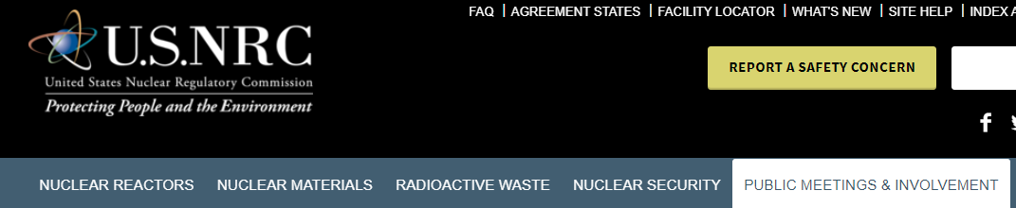
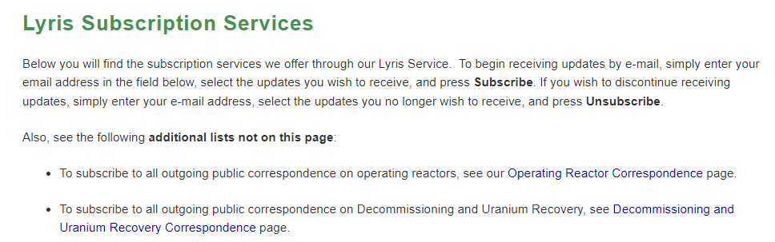

Receive Links for Public
Documents for TMI-2 via Email
Go to www.nrc.gov
Select Public Meetings and Involvement
Select Subscribe to Email Updates
Scroll down to Lyris Subscription Services
  Click the link to the Decommissioning and Uranium Recovery Correspondence page
Add your name and email address and select Three Mile Island Station, Unit 2 -5000320 (Middletown, PA)
  As items are put on the docket, you will get an email notification

Slide 29
Oversight Comments
Bill Ostendorff, Chairperson
Decommissioning Nuclear Safety Review Board
Dwight Shearer, Director
PADEP Bureau of Radiation Protection
Amy Snyder, Senior Project Manager
Nuclear Regulatory Commission

Slide 30

Three Mile Island Station, Unit 2
March 5, 2025:
Public Meeting Summary on Three Mile Island Station, Unit-2 Decommissioning with the Nuclear RegulatoryCommission(ML25072A247)
March 12, 2025:
Three Mile Island, Unit 2, Updated Information for the TMI-2 Post-Shutdown Decommissioning Activities Report, Rev.6(ML25071A418)
Notes:
Should you have any further questions or comments, please do not hesitate to contact our Public Affairs Office. The contact information can be found on this slide.
Thank you for your interest and participation in this presentation.
Now let’s get to your questions.

Slide 31
Questions and NRC Contacts
Amy Snyder,
Senior Project Manager
Amy.Snyder@nrc.gov
or 301 415-6822
Katherine Warner
Senior Health Physicist, Region I
katherine.warner@nrc.gov
610-337-5389
Diane Screnci
Senior Public Affairs Officer, Region I
Diane.Screnci@nrc.gov
610-337-5330
Doug Tifft
State Liaison, Region I
Doug.Tifft@nrc.gov
610-337-6918
Notes:
Should you have any further questions or comments, please do not hesitate to contact our Public Affairs Office. The contact information can be found on this slide.
Thank you for your interest and participation in this presentation.
Now let’s get to your questions.

Slide 32
CAP Business (cont.)
Dave Allard, Chairperson
- Date for the next meeting of the TMI-2 CAP
- CAP outreach to local community & stakeholders…

Slide 33
Community Q&A
Please contact Joe Lynch at jrlynch@energysolutions.com
with any additional questions or requests for information.
Tentative Next Meeting:
Wednesday, September 24, 2025
Time: 6:00pm – 7:30pm

